Slide 1



YouTube trend video in US
Breaking USA YouTube Algorithm:
Insights into Trending Videos and Engagement
Done by:
Noor Ali
Noor Ahmed
Duaa Mohamed

Slide 2
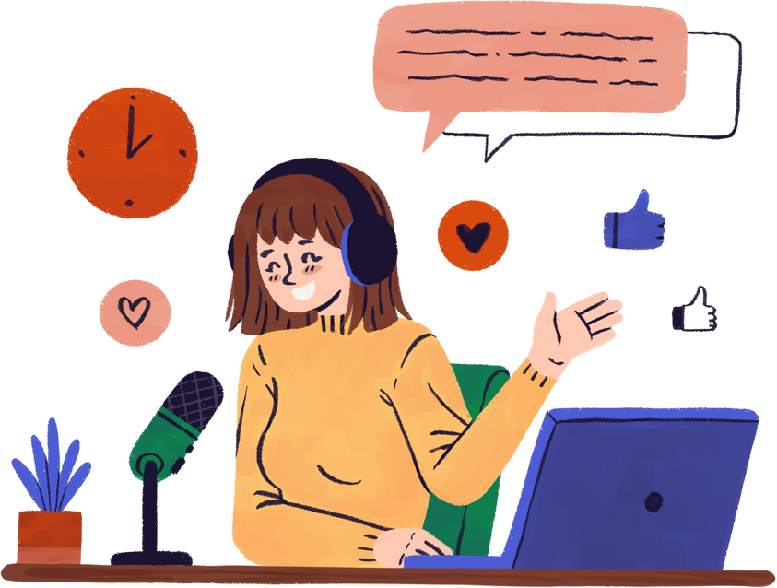
Introduction
YouTube is the most widely used video platform in the U.S., with over 247 million users. It serves as a hub for entertainment, education, and content creation. Many American creators earn income through ads, sponsorships, and merchandise, making YouTube both a cultural and economic force in the country..
(Shewale, 2025)

Slide 3


Problem Statement
YouTube’s trending algorithm can significantly impact a video’s exposure and audience reach. However, the dynamics of what makes a video trend remain unclear.
Our Aim analyze YouTube trending videos to identify key patterns and factors that impact a video's chances of trending and its engagement, aiming to help creators improve visibility and reach.

Slide 4

Project Objectives
Objectives
Identify top trending video categories
Measure engagement across categories
Analyze effect of publish day and time
Examine traits of frequently trending channels
Explore common tags and keywords
Determine average time to trend
Evaluate consistency in engagement by category

Slide 5

Analysis

Slide 6
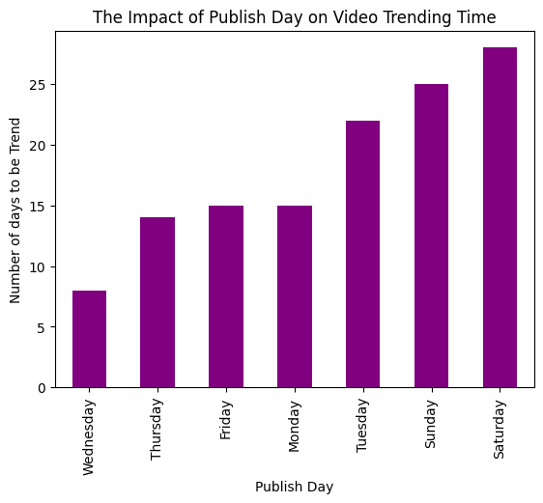

Average Days to Trend by Publishing Day
Wednesday - most probably to be trend faster
Thursday , Friday and Monday - second faster days to trend
Sunday and Saturday - take longer to be trend

Slide 7
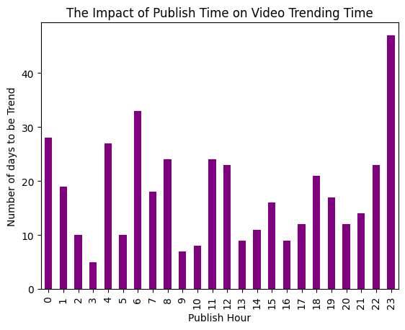

Average Days to Trend by Hour
Publishing at 03:00 am has higher potential to be trend
Publishing at 11:00 pm has the least potential to be trend

Slide 8
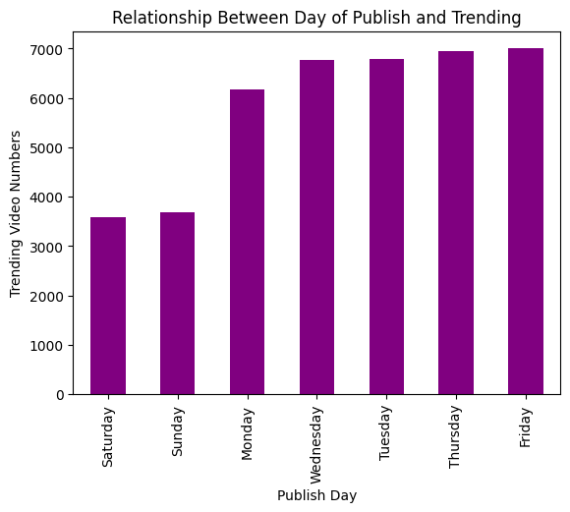

Count of trending videos by day
Saturdays and Sundays - least Number of trending videos
Wednesdays and Tuesdays - Second highest Number of trending Videos
Thursdays and Fridays - highest trending video numbers

Slide 9
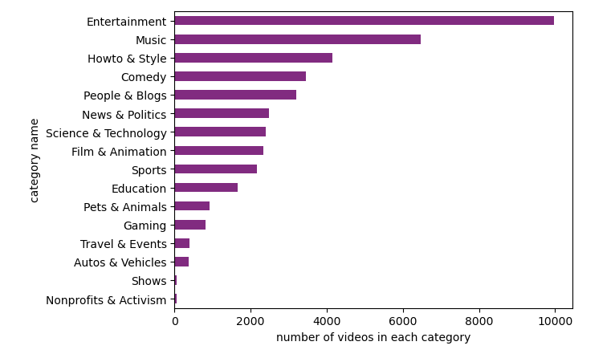

The Most Frequently Trending Video Categories on YouTube
Entertainment - most frequently trend category
Music - second most frequently trend category
Shows and Nonprofits & Activism

Slide 10
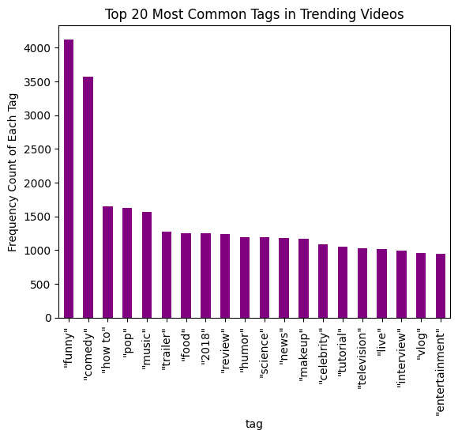
Most Common Tags or Keywords Used Among Trending Videos
Funny and Comedy - most common used tags
how to , pop and music - second most common used tags
interview, vlog and entertainment - least used tags

Slide 11
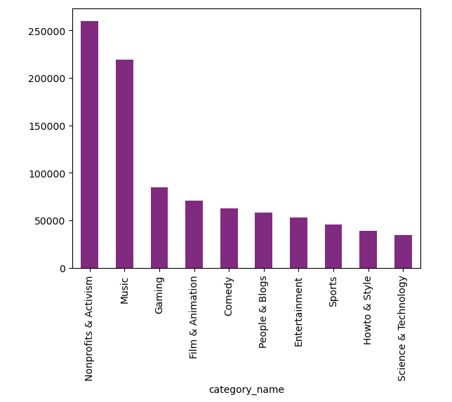
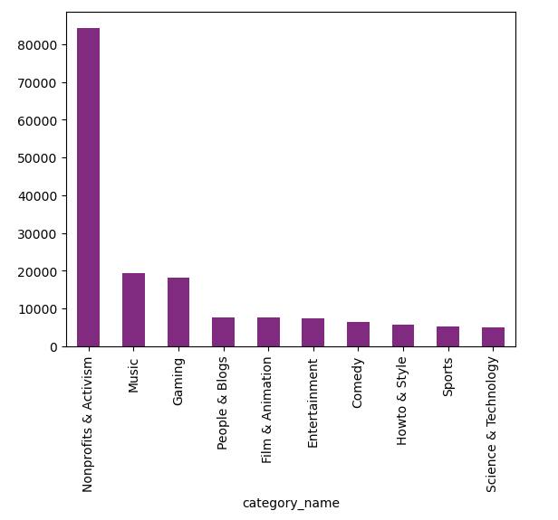
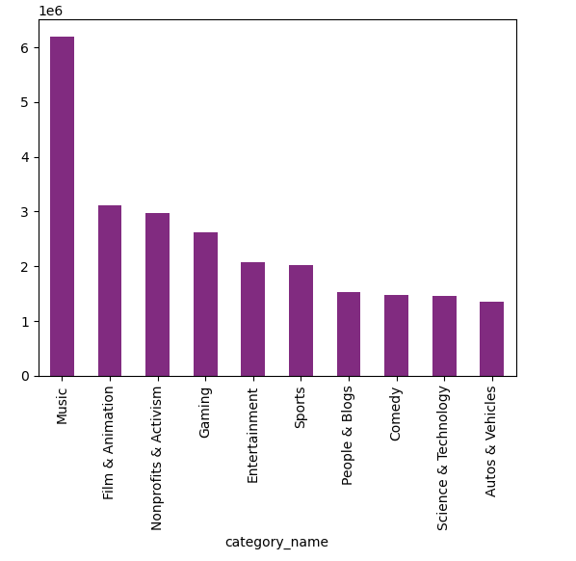
The Highest Engagement
likes
comments
views

Slide 12
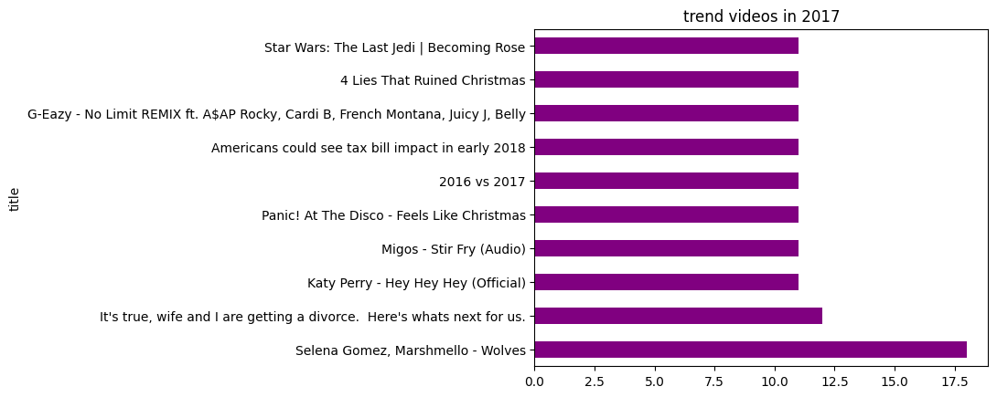
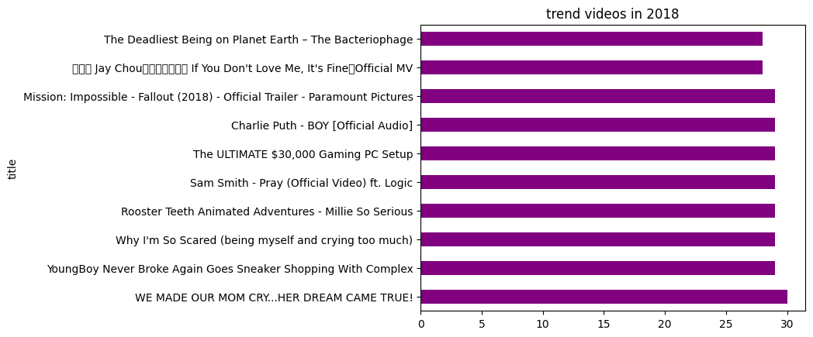
Top trend videos in
2017, 2018

Slide 13

Recommendations
Now your audience and create content that connects with them.
Use eye-catching titles, tags, and thumbnails to increase discoverability.
Study what works — look at top channels and videos for inspiration.
Stay consistent, keep learning, and be ready to adapt to new trends.

Slide 14

Conclusion
Trending on YouTube depends on more than just views — category, content style, and audience interaction all matter.
Channels that understand what their audience likes are more likely to trend.
Trends change, but good content with the right strategy always performs well.

Slide 15
Thank You

